Slide 1
Psychological Foundations of Good User Experience
Chris Woodard

Slide 2
What Makes a Good UX?
The user understands the application without constantly having to consult the documentation.

Slide 3
What Makes a Good UX?
The user understands the application without constantly having to consult the documentation.
The user can easily discover how to navigate the application.

Slide 4
What Makes a Good UX?
The user understands the application without constantly having to consult the documentation.
The user feels empowered to explore the application because the navigation flow and controls are consistent.

Slide 5
What Makes a Good UX?
The user understands the application.
The UI presents all of the information the user needs to use the app.
The UI doesn’t distract the user with gratuitous text/graphics or useless animations.

Slide 6
What Makes a Good UX?
The user understands the application.
The UI presents all of the information the user needs to use the app.
The UI doesn’t distract the user with gratuitous text/graphics or useless animations.
The colors, fonts, graphics and animations in the UI work with each other and not against each other.

Slide 7
What Makes a Good UX?
The user understands the app.
The UI presents all of the information the user needs to use the app.
The UI doesn’t distract the user with gratuitous text/graphics or useless animations.
The colors, fonts, graphics and animations in the UI work with each other and not against each other.
The emphases, controls and navigation metaphors mean the same thing anywhere in the app.

Slide 8
Start with a model for how people perceive visual displays

Slide 9

Feature Integration Theory of Visual Processing - In Steps
Visual Display
Feature Maps
Feature Detection
Visual display is decomposed into feature maps.
Feature maps preserve the x-y geometry of the visual scene as well as the presence (or value) of the particular feature at the x-y location
brightness
color
line segments
…

Slide 10
Feature Integration Theory of Visual Processing - In Steps
Feature Maps
Possible Objects
Candidate Object Assembly
brightness
Entries in feature maps are combined to form possible or candidate objects
Candidate objects are processed further up the processing chain
candidate 1
color
candidate 2
line segments
candidate 3
candidate …
…

Slide 11
Feature Integration Theory of Visual Processing - In Steps
Possible Objects
Generation of Possible Responses or Actions
Decision / Selection
Candidate objects can raise multiple possible responses or actions
choice 1
candidate 1
choice 2
candidate 2
choice 3
candidate 3
candidate …
choice …

Slide 12
Feature Integration Theory of Visual Processing - In Steps
Possible Responses or Actions
Execution of Selected Response
Decision / Selection
Number of responses that can be executed at one time is limited.
choice 1
choice 2
choice 2
choice 3
choice …

Slide 13
From that model:
Recognizing objects across the entire display requires a lot of processing of a lot of combinations.
Very difficult to do quickly unless there is some way to limit the number of features that have to be assembled and tested.

Slide 14
Focus of Attention
Focus of attention “draws a boundary” around the x,y locations. Features inside that boundary are assembled and tested; features outside that boundary are not.
Often called “the attention spotlight”

Slide 15
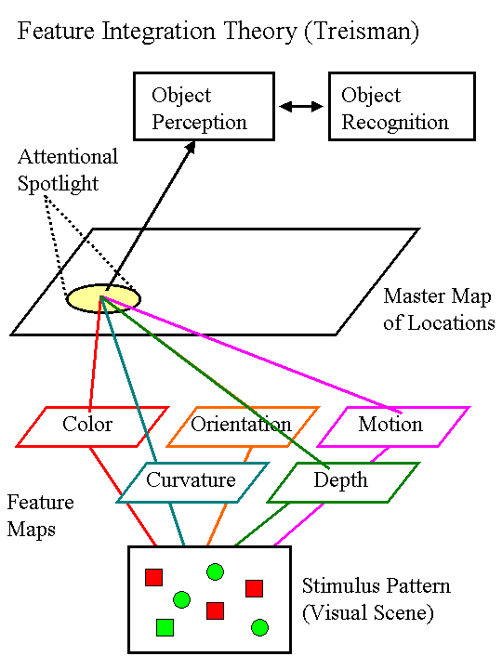
Feature Integration Theory of Visual Processing
One dominant theory is called “feature integration theory” (Triesman, xxxx).
The data that support it include the visual search task.

Slide 16
Visual Search Task
Subject is told to search for a particular object (called the target) among a group of other objects (called distractors).
Experimenter measures how long it takes the subject to find the target among the distractors.
If it takes the subjects longer the more distractors there are, then recognizing the distractors is interfering with recognizing the target.

Slide 17
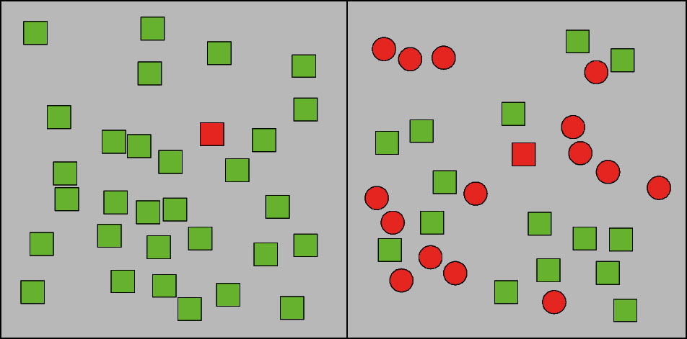
Visual Search Scene

Slide 18
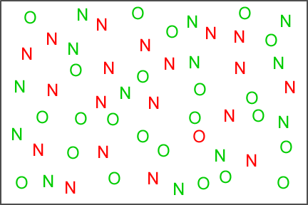
Visual Search Scene

Slide 19
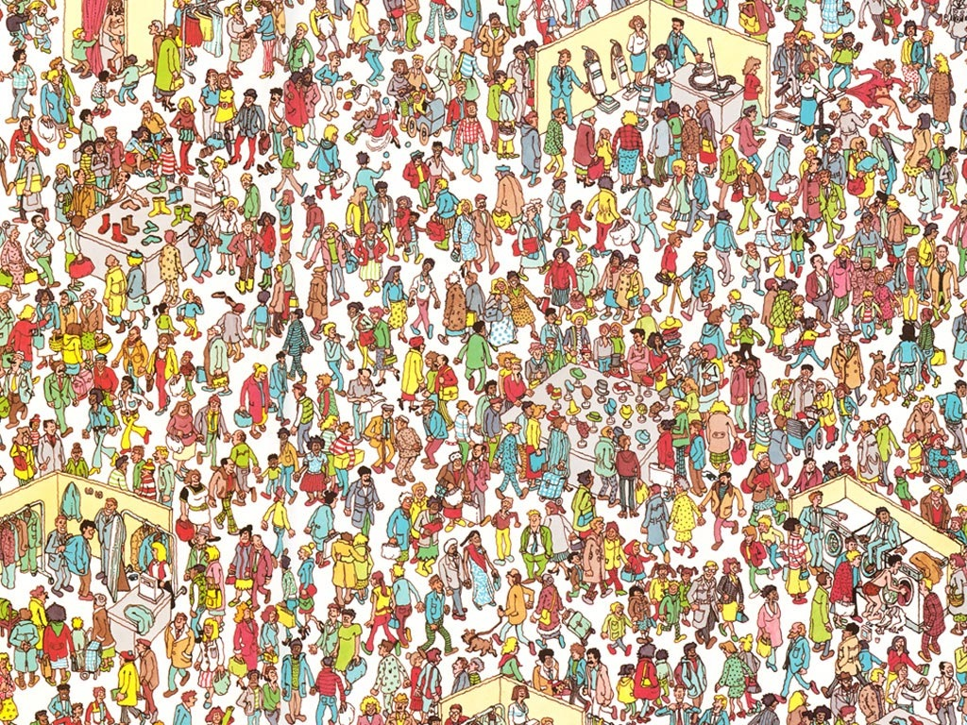
Visual Search Scene

Slide 20
How do our brains know where to focus attention?

Slide 21
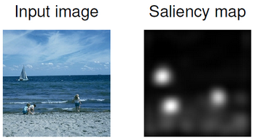
Directing the Focus of Attention
Spotlight is drawn to areas in the feature map by a saliency map. This provides hints as to where in the feature maps to begin focusing attention in order to process and recognize objects.

Slide 22
What is “Salient”?
Saliency map is computed from local discontinuities in brightness, color or contrast.
Helps object recognition by allowing visual system to temporarily ignore some areas in feature maps while testing candidate objects
Speeds up visual search by directing focus of attention to certain areas in the display.

Slide 23
So Far…
Visual display is decomposed into feature maps
Brain assembles the features in the feature maps into candidate objects.
Candidate objects activate responses or choices. “Best” one wins.
Visual attention helps limit the area in the feature maps that get used to build candidate objects.
“Saliency map” helps guide attention around the display to areas likely to contain objects.

Slide 24
Once objects are recognized…
They are added to a cognitive representation of the display scene. this is higher level and forms part of the mental model of the app or web site.
Once they’re in this cognitive representation, they are used to select a response.
Once the response is selected, it’s executed.

Slide 25
Design Advice
When creating your UI, don’t overcrowd the display.
Don’t use busy backgrounds if text or pictures or anything else is going to be displayed on top of them.
When attention is to be focused on a specific part of the display, don’t put really salient things in other parts of the display.

Slide 26
Responses that don’t get along
Objects and qualities that elicit responses can sometimes elicit conflicting responses.
A really common example of this is the Stroop Task, in which subjects are shown the names of colors. The names are either printed in the color of ink (e.g. the word ‘green’ in green ink) or a different color of ink (e.g. the word ‘yellow’ in purple ink). They are then supposed to repeat the name text.

Slide 27
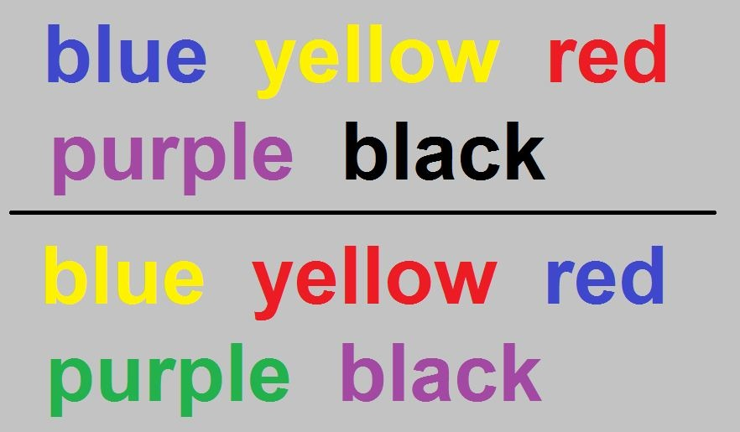
Stroop Task

Slide 28
Stroop Task
Color names that have the same color ink as their name are normally quicker to name.
Color names that have different color ink from their name are normally slower to name.

Slide 29
Stroop Task
Color names elicit one response.
Ink colors elicit a second response.
If the responses are not the same, they compete and the subject/user is slower to respond.

Slide 30
Design Advice
When designing the action items in the UI, don’t make them look like one thing but act like another (e..g. don’t make a draggable item shaped like a button).
Be clear about what each action item (button, link, etc.) does. Ambiguous items will get filled in by the user and response competition can result.

Slide 31
What Makes a Good UX?
The user feels empowered to explore the application because the navigation flow and controls are consistent.

Slide 32
Affordances
Affordances are ways of working with an application that the user can ‘take for granted’, the same way people take for granted that doorknobs turn and chairs can be sat on.
Affordances make it possible for the user not to have to learn how to navigate your application all over again.
Exploiting existing affordances lessens the amount of work the designer and developer have to do.

Slide 33
Affordances
In software, affordances mean things like “click on this underlined blue text and see a new page” or “tap on this button and the window slides to the right”.
Changing the affordances that users depend on is a sure way to get howls of protest.

Slide 34
Metrics
Cognitive and perception experiments overwhelmingly use two metrics: choice probability and response time (or reaction time).
These can be very useful adjuncts to A/B testing or focus group testing.
If on average the time needed to take some action on a web page or app view is long, the page or view may be too complex.

Slide 35
Metrics
Implementing these in web applications requires Javascript and some encoding of the individual pages.
Choice probability can be collected as well.
WebKit-based browsers can store data in SQLite databases, so the reaction time and choice probability data can be cached and uploaded or collected later.

Slide 36
Further Reading
http://en.wikipedia.org/wiki/Stroop_effect
http://en.wikipedia.org/wiki/Feature_integration_theory
http://www.scholarpedia.org/article/Saliency_map

